Slide 1

Game Store

Slide 2
Who are we?
We are a game development company, looking for professionals who want to grow together with the company, developing unique experiences.

Slide 3
Why?
Our company aims to show people that game development is possible for anyone, with willpower and dedication everything is possible, the Game Store will provide all the support and resources for our professionals.

Slide 4
Fairy Tale: The Lost Earrings
The game

Slide 5
About Fairy Tale
Fairy Tale: The Lost Earrings tells a story of envy and evil, but the act of forgiving can save lives. Fairy Tale tells the story of two girls studying magic, Morgana and Arcadia, Morgana a woman with an intense and intriguing personality, Arcadia sweet and friendly, very beautiful and intelligent.

Slide 6
Game Design
Fairy Tale is a Top-Down and Rogue Like game, with simple mechanics, with intense combat, demanding more from the player's reaction

Slide 7
Game Arts
Arts development

Slide 8
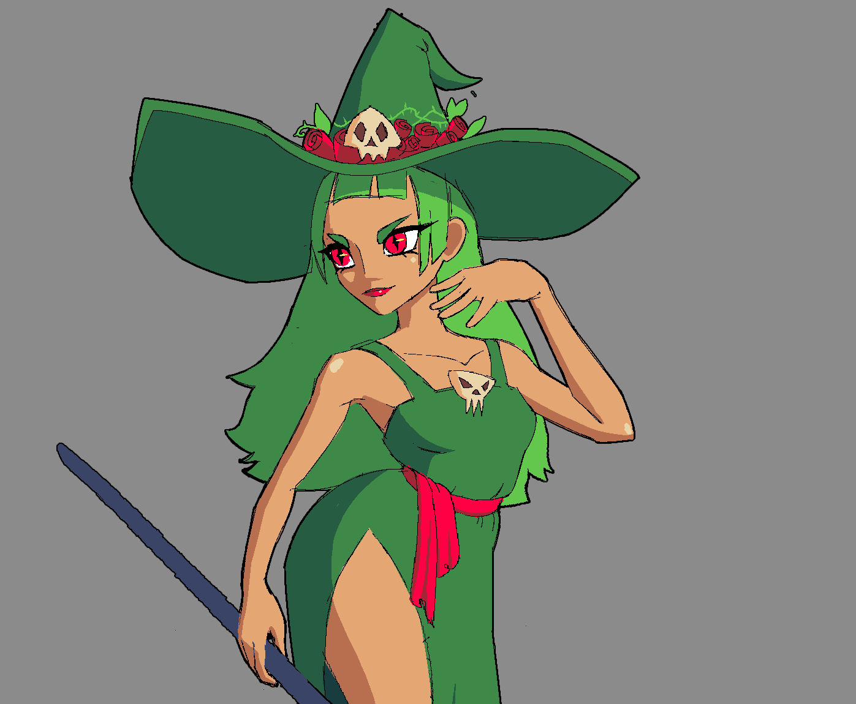
Fairy Tale Arts
The art style adopted for Fairy Tale is pixel art, this art works pixel by pixel to achieve these beautiful results. But before starting with the pixel art, we made a designed model.
(That would be Morgana)

Slide 9
Making Art
Bringing an idea to life such as a character, animation or pixel art can be a difficult task if done incorrectly, and a very efficient way is to divide the work into stages. For example, although my main goal is to create animations to bring the game's characters to life, I don't start directly with that part. Before the animation, I do other arts of different types, which serve as a guide and, little by little, step by step, I shape the work.
By Luís Fernando Ferreira (Game Artist)

Slide 10
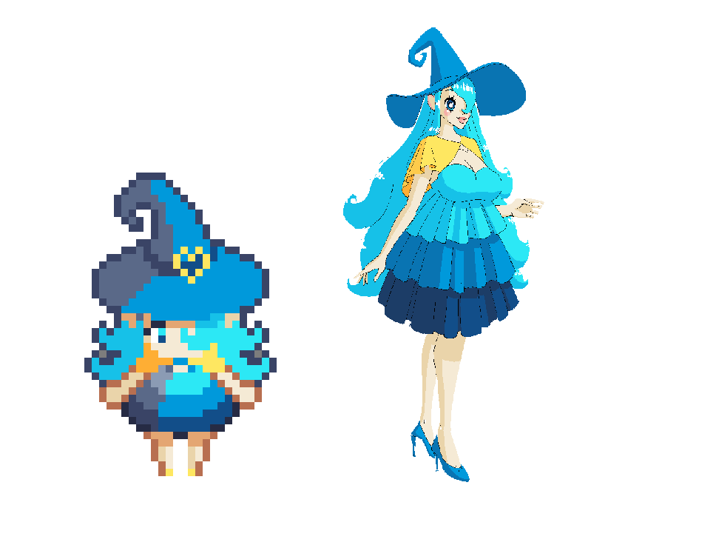
Fairy Tale Characters
The characters were designed in such a way that they are unique, with unique characteristics, which make them captivating and visually pleasing.

Slide 11
Programming
Programming the Game

Slide 12
Programming game
Programming a game is a complex task, and it has to be done well, a poorly programmed game can lead to bad gameplay. Fairy Tale was made on Godot, a game engine.

Slide 13
What was it like programming Fairy Tale?
It was a very cautious process, as the user experience is very important, so we took great care to be able to offer the best experience for the player, with fluid combat and fun mechanics.

Slide 14
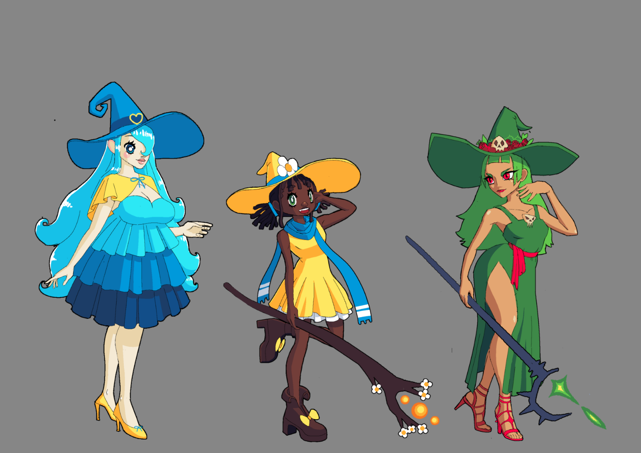
Fairy Tale: The Lost Earrings
All Characters (Arcadia, Lisa e Morgana)

Slide 15
The video of prototype game

Slide 16
Finishing
Finishing presentation

Slide 17
Credits
Luís Fernando Ferreira – Art, Animation and Characters
Thomas Sena – Art and Animation
Daniel Lima – Game Design and Programmer

Slide 18
Conclusion
Fairy Tale: The Lost Earrings will be the first of many other successful Game Store games.

Slide 19
Thanks
Thanks for hearing a little about this amazing game, thanks to everyone who made this possible.

